Slide 1
Blood, Sweat, and Code Reviews
Why are code reviews important?
How can we make them better?

Slide 2

David Giard
Microsoft
Cloud Solution Architect

Slide 3

Jack
Notes:
Jack spent days writing a software component. He tested and double-checked his code, and he was satisfied that it worked properly, according to the requirements he was given, so he checked it into source control. A few weeks later, a new version of the software that included his code was released to production. A user discovered a bug caused by Jack's changes. The user tweeted about the bug, and this was retweeted thousands of times. Before long, word got back to Jack. An edge case that Jack had not considered was causing problems in production. He fixed the bug and checked his changes back into source control. And he waited. Hoping for the best.

Slide 4

Joe
Notes:
Joe spent days writing a software component. He tested and double-checked his code, and he was satisfied that it worked properly, according to the requirements he was given, so he checked it into source control. Joe's team had a policy that required a code review prior to merging any code with the main branch. During the code review process, one of Joe's peers pointed out a bug in his code. It was an edge case that Joe had not considered. He fixed the bug and checked his changes back into source control. The code was reviewed again and merged with the main branch. Joe slept well that night.

Slide 5
Agenda
Definitions
Purpose of a Code Review
Challenges
Techniques for Code Reviewer
Techniques for Code Author
Further Reading

Slide 6
Definitions
Change Set
Change List
Pull Request
Notes:
The author's changes are known as a "Change Set"; the description of those changes is a "Change List"; many Application Lifecycle Management tools (e.g., GitHub and Azure DevOps) support a "Pull Request", which combines the two with the source code and is a formal entry point for the Reviewer to begin reviewing the code changes. I often use these three terms interchangeably because they are so closely related.

Slide 7

Two Parties in Code Review Process
Code Author
Code Reviewer

Slide 8
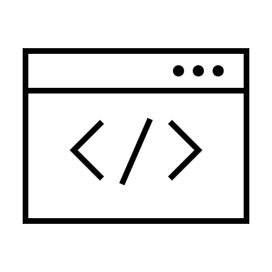


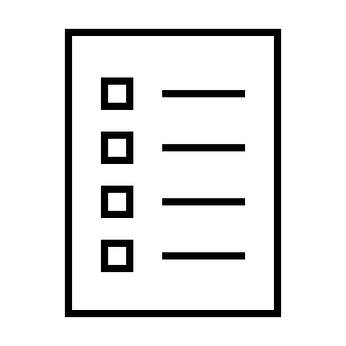
Code Review process
Code Author
Code Reviewer
Notes:
The steps in a code review are:
The Code Author makes changes to an application and checks those changes into a code repository
The author sends a description of changes to the Code Reviewer. The changes are known as a "Change Set"; the description of those changes is a "Change List"; many Application Lifecycle Management tools (e.g., GitHub and Azure DevOps) support a "Pull Request", which combines the two with the source code and is a formal entry point for the Reviewer to begin reviewing the code changes. I often use these three terms interchangeably because they are so closely related
The Code Reviewer retrieves the code, examines it, and (if necessary) provides feedback on changes that the author must make before the code can be merged with the main branch
If the code requires changes, the Reviewer sends the feedback to the Author
The Author responds to the feedback and makes any necessary changes
The Author re-sends to the Reviewer the code with these updates
Steps 3-6 are repeated until no more changes are required
When no more changes are required, the Reviewer approves the changeset
The code is merged with the main branch in the repository

Slide 9
Purposes of Code Review
Validate code
Internal Quality
External Quality
Share Knowledge
Increase Code Ownership
Make Engineering Decisions
Address weaknesses
Compliance

Slide 10
Validate Code
External
Does the code do what it is supposed to do?
Internal
Does it follow team’s guidelines?
Any potential problems?
Can it be improved?
Notes:
The most obvious reason to review code is to validate that it does what it is supposed to do. Generally, we look at this from an external point of view. For example, if we provide a given set of inputs to a function, we verify that the function returns the expected output. We can pull the code from source control and make sure it compiles and runs successfully. We can execute automated tests and validate that they all pass.
But we also want to validate the code from an internal point of view. If our team has coding standards, does the code adhere to those standards? While reviewing code, the reviewer looks for and calls out potential problems. Even if the code works well, there may be potential areas for improvement. For example, the reviewer may suggest ways to make the code more efficient, faster, or more readable. The reviewer should point out these as well.
References:
“Code Complete” by Steve McConnell
Code reviews reduce bugs by 80%
AT&T Study
Code reviews showed 90% reduction in defects
Jet Propulsion Laboratories reported
$25,000 savings from early code reviews
Source: Engineering manager’s guide to code review (pluralsight.com)

Slide 11
Share Knowledge
Others learn about code base and business rules
Share technology learnings
Notes:
There are two parties involved in a code review process: the code author and the code reviewer. By reviewing the code, the reviewer has a chance to improve the code itself and to address any weaknesses or knowledge gaps in the developer. Similarly, the reviewer can address his or her own weaknesses by seeing someone else's approach to a coding challenge.
The reviewer gains knowledge about a part of the system that someone else wrote. By reading the code, they may also learn something about the language in which it was written; or about a framework or a design pattern or an algorithm implemented by the author; or about the business cases and requirements of the application.
In addition, the code author can learn by reading feedback from the reviewer, who may suggest improvements that the coder did not consider.
I have worked on too many systems in which one developer possessed all knowledge about a part of that system. Confusion reigned when that developer left the team. No one understood how to maintain the orphaned code. By conducting regular code reviews, team members have a chance to understand parts of the system on which they are not actively working. This shared knowledge benefits the whole team, allowing flexibility in staffing and removing the danger of all knowledge departing when a team member departs.
---
Cross-training employees reduces the cost of worker turnover

Slide 12
Make Engineering Decisions
How do we access data?
What do we test?
Coding standards
Notes:
Sometimes, a code review can drive engineering decisions. If there is confusion or inconsistency about how the application is accessing data or dividing services or testing code, code reviews can raise these issues and prompt a discussion. If different developers have different coding standards, it may indicate a gap in the team's standards and drive discussion around this.
Effective teams have published a set of coding guidelines that may describe everything from naming conventions to required test coverage. Developers must be aware of these guidelines and make an effort to adhere to them; but often non-compliant code slips through. A code review is a good place to catch this before the code is committed to the main branch.

Slide 13
Address Weaknesses
In code
In developers

Slide 14
Long-Term Benefits
Less Time on Rework
Fewer Issues in Integration Testing
Fewer service and support calls
Catch bugs sooner

Slide 15
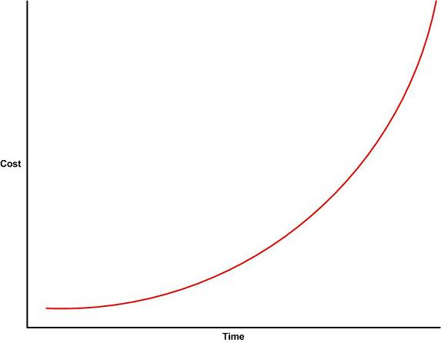
Cost of Software Change
Source: Why Agile Software Development Techniques Work: Improved Feedback (ambysoft.com)

Slide 16
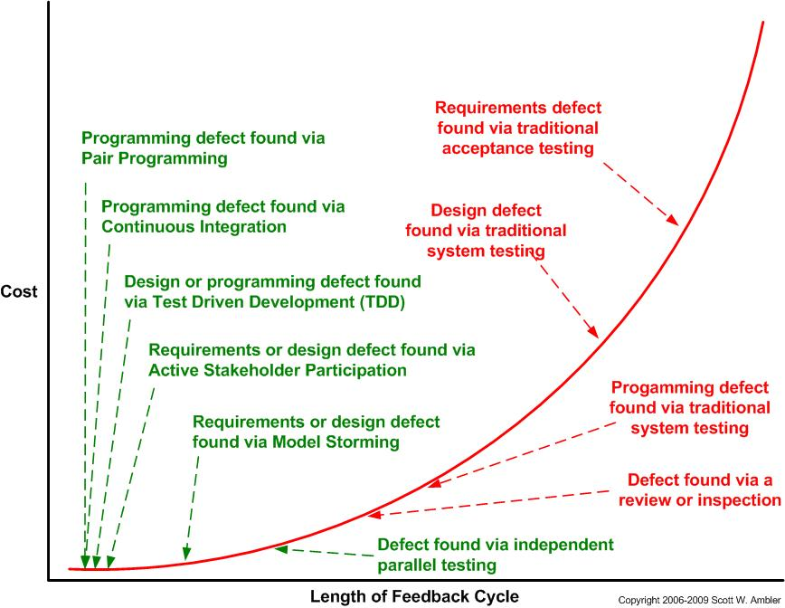
Cost of Software Change
Source: Why Agile Software Development Techniques Work: Improved Feedback (ambysoft.com)

Slide 17
Challenges
Notes:
Miscommunication is higher in written feedback
Limited Focus Time and Mental Stamina
Code reviews take time. perception that reviews slow down project
Criticism can be taken personally
Reviews often block other changes
There is often more than one correct solution to a problem
Different opinions

Slide 18
Challenges for Author and Reviewer
Code reviews take time
Limited time and stamina
Reviews often block other changes
Miscommunication
Different opinions
There is often more than one correct solution to a problem
Individual accomplishments vs. collaboration
Notes:
Miscommunication is higher in written feedback
Limited Focus Time and Mental Stamina
Code reviews take time. perception that reviews slow down project
Criticism can be taken personally
Our education system rewards individual accomplishments; not collaboration

Slide 19
Challenges for Reviewer
Pointing out errors is unnatural for many of us
Belief that I know less than the author

Slide 20
Challenges for Code Author
Criticism can be taken personally
Fear of management disapproval, if bugs found
Notes:
Criticism can be taken personally

Slide 21
How Can We Make Code Reviews Better?

Slide 22
Techniques for Code Reviewer
What can the Reviewer do to make a Code Review more effective?

Slide 23
Don’t Delay
Notes:
Everything is fresh in their mind
Easier to merge when complete
Incentive to create smaller changesets

Slide 24
Work High Level to Low Level
Notes:
Start high level and work your way down
High Level: Class structure, interfaces
Low level: Code implementation
If many high-level changes, skip the details
Author may fix low level stuff when they address the high level change

Slide 25
Use the Computer
Notes:
Let the computer take care of the boring parts:
Compilation
Unit Tests Pass
Formatting (whitespace, casing of names, unused imports)
Tools:
Compiler
Linting
Styling tools
DotNet Code Formatter
Java: Google-Java-Format
Javascript Standard Style (N.B. this is a product name, not an actual, official JavaScript standard)
PHP Coding Standards Fixer
Python: Google’s YAPF
Ruby: Rubocop

Slide 26
Create a Style Guide
Create your own
Borrow one (e.g., google.github.io/styleguide)
Allow guide to evolve over time
Don’t waste review time arguing over style
Notes:
Google has a style guide for several languages
Google Style Guides | styleguide

Slide 27
Include Code Examples
Notes:
Be generous with code examples
Author may not be familiar with a technique you suggest
Caution:
Reserve for things that would be much more efficient (e.g., significantly reduce lines of code)
Not too much. You don’t want author to think you don’t trust them to write their own code

Slide 28
Do Not Make It Personal
Do Not Say “YOU”
Requests; not Commands
Principles; not Opinions
Notes:
Say “We” or refer to the code
Use the passive voice to soften tone (only time you will hear me say this)
Frame feedback as requests, not commands
Tie notes to principles, not opinions
e.g., this should be 2 classes because it does 2 different things (Single Responsibility Principle)

Slide 29
Prefix review comments with labels:
Issue:
Suggestion:
Question:
Nit:
Thought:
Chore:
Praise:

Slide 30
Prefix review comments with labels:
Issue: This method does 2 things; violates the SRP
Suggestion: Consider splitting this into 2 methods
Question: Why did you choose the ArrayList instead of the List class?
Nit: A better name for this method might be “GetAllProducts”
Thought: Here is a library that does this for you
Chore: “Customer” is misspelled
Praise: Clever refactoring! Much more readable!
Notes:
Conventional: Comments | Medium
Issue: Specific problem. Pair with suggestion
Suggestion: Suggested improvement
Question: Potential concerns, but not sure if relevant
Nit: Trivial, but necessary changes
Thought: Non-blocking ideas
Chore: Simple tasks that must be done
Praise: Highlight something positive

Slide 31
Praise Sincerely
Notes:
Offer sincere praise

Slide 32
Avoid Repeating Feedback
e.g., “See naming convention comment above”
Notes:
Limit feedback on repeated patterns
Combine similar comments (e.g., “See naming convention comment above”)

Slide 33
Consider the Scope of the Review
Avoid feedback on lines that did not change
Exceptions
Trivial change and few other feedback items
Change affected a line (e.g., the name of a function whose body changed)
Notes:
Respect the scope of the review

Slide 34
Stalemates
Symptoms
No progress
Tension
Cures
Discuss
Design Review
Concede
Escalate

Slide 35
Goal: Improve Code
Notes:
Not every Code Review needs to make the code perfect
If there are many issues, aim to bring the code up a letter grade or two
The next review can bring it up more
This prevents the review from dragging on too long and becoming bogged down in trivial arguments
Look for opportunities to split up large reviews
Approve, if only Trivial Fixes Remain

Slide 36
Best Practices for Reviewer
Actionable Comments
Combine Similar Comments
Don’t Make It Personal

Slide 37
Techniques for Code Author
What can the Code Author do to make the code review more productive?

Slide 38
Test, Test, Test!

Slide 39
Use the computer
Notes:
Automate the easy stuff
compiler
linter
Automated tests

Slide 40
Review your own code first

Slide 41
Communicate Clearly
Notes:
Write a clear change list description
Respond with what you changed
Solicit missing information

Slide 42
Answer questions with the code
Refactor to make it more readable
Eliminate confusion
Notes:
If the reviewer is confused by your code, go back to the code and make it self-documenting

Slide 43
Keep it Simple
Narrow scope changes
Break up large change sets
Separate functional and non-functional changes
Notes:
Non-functional changes
refactoring code
changing formatting (e.g., indentation)
These can often show every line as “changed” in diff view

Slide 44
Stay Cool
Respond graciously
Be patient when reviewer is mistaken
Notes:
Be grateful for feedback
Catching errors is a sign your code is structured in a way that makes it easier to find errors
If the reviewer is wrong, it may be a sign that your code can be refactored to make it more readable

Slide 45
Respond Quickly
Notes:
Minimize lag between rounds of review

Slide 46
Award ties to your reviewer

Slide 47
Best Practices for Code Author
Review First
Small change sets
Readable Code
Clear Communication
Do Not Take It Personally

Slide 48
Best Practices Common to Author and Reviewer
Keep review time short
Maintain respectful communication
Never make it personal

Slide 49
For Managers
Rotate who reviews whose code
Make sure each engineer is authoring and reviewing
Set policies to require code approval before a PR merge
Foster a culture of teamwork

Slide 50
Links
These Slides
tinyurl.com/bloodsweatcodereview
Code Review Articles – davidgiard.com
davidgiard.com/code-review-articles
How to Do Code Reviews Like a Human
Part 1: mtlynch.io/human-code-reviews-1/
Part 2: mtlynch.io/human-code-reviews-2/
How to Make Your Code Reviewer Fall in Love with You
mtlynch.io/code-review-love/
The engineering manager's guide to the code review process
www.pluralsight.com/blog/tutorials/code-review
Convention: Comments
a-hemdan.medium.com/conventional-comments-1f83f56a7a48
Why Agile Software Development Techniques Work: Improved Feedback
http://www.ambysoft.com/essays/whyAgileWorksFeedback.html

Slide 51
David Giard
{ "name": "David Giard", "title": “Cloud Solution Architect", "employer": "Microsoft", "email": "dgiard@microsoft.com", "twitter": "@DavidGiard", "blog": "davidgiard.com", "TV": [ { "title": "Technology and Friends", "description": "Talking with smart people about technology", "url": "http://technologyandfriends.com" }, { "title": "GCast", "description": "Screencast demos showing how to do tech stuff", "url": "https://aka.ms/gcast" } ] }

Slide 52

THANK YOU!

Slide 53
More reading
How to Do Code Reviews Like a Human (Part One) · mtlynch.io
How to Do Code Reviews Like a Human (Part Two) · mtlynch.io
How to Make Your Code Reviewer Fall in Love with You · mtlynch.io
Humanizing Peer Reviews by Karl E. Wiegers
Engineering manager’s guide to code review (pluralsight.com)
Conventional: Comments | Medium

Slide 54
